Slide 1
Becoming an Antiracist Learning Community
Our secret… we’re not done
Amy Smith, CFRE
Casey Therrien, CFRE

Slide 2
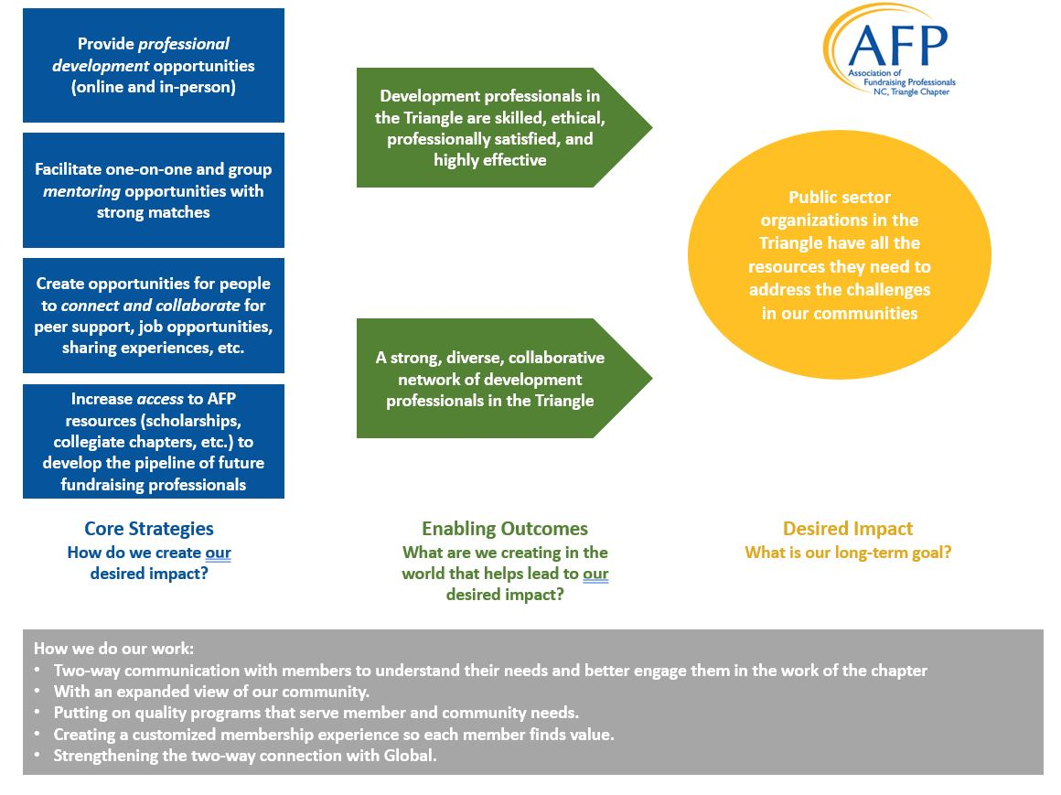
AFP Triangle Theory of Change

Slide 3
Board Commitment
Non-negotiable, stated during recruitment shared expectation
Board members of color are NOT asked nor expected to join IDEA Committee – If they want to join, they are welcome to do so
In 2023, a required board training is a part of the commitment

Slide 4
Scholarships
Multi-Year Scholarships
  Two scholarships awarded each year
  Covers 3 years of Global + local Chapter Membership
  Complimentary registration for Chapter Sponsored Events
  Changing the name of Diversity Scholarship to Three-Year IDEA Scholarship
Processed through the IDEA committee
Strategic application process

Slide 5
Measurement
In 2022, began tracking board member demographics
Using this information in board recruiting to help recruit a board that better reflects our communities
Asking more demographics questions in our scholarship processes to better measure our impact and outreach

Slide 6
Investment
The 2021 board made a $10,000 investment in advancing antiracist work for our community
Pay what you can model for IDEA Training
$10,000 grant from local community foundation
It was important to us that we live our values
  Moved one of our CDs to the second largest Black-owned bank in the nation
This was NOT an easy transition
  Provided an opportunity for AFP Triangle to share our values and re-iterate why this is important

Slide 7
BIPOC Fundraisers Affinity Group
Created in 2022
Created a safe space for BIPOC fundraisers to get together both virtually and in-person
NO expectation that anyone in the group will join AFP if they are not a member
In 2023 we are looking to grow the impact for this group

Slide 8
Sponsorships
Hard conversations between Co-Presidents and President-Elect of what our stance is on white led sponsors wanting to express “white saviorship,” towards BIPOC affinity group and multi-year scholars
Conversation about total investment in community and not just to check off “supported BIPOC”
Worked with sponsor and they are now offering three scholarships for members of the BIPOC Fundraisers Group

Slide 9
Resources
“How To Be An Antiracist,” Ibram X Kendi
“Stamped from the Beginning,” Ibram X Kendi
“The Black Friend,” Frederick Joseph
“So You Want to Talk about Race,” Ijeoma Oluo

Slide 10
Work/Speakers
The chapter has worked with all the following IDEA professionals to help facilitate conversations and advance our IDEA work:
  I Follow the Leader, LLC
  The Equity Paradigm
  Evangeline Weiss
  Mattingly Solutions, LLC

